Slide 1


The Updated Vision for 5G
Esfand 1396
Sharif University of Technology

Slide 2




1G and 2G (1979-2000)

Slide 3


2.5G-4.5G (2000-2018)
Video
Video
100111001
100111001

Slide 4
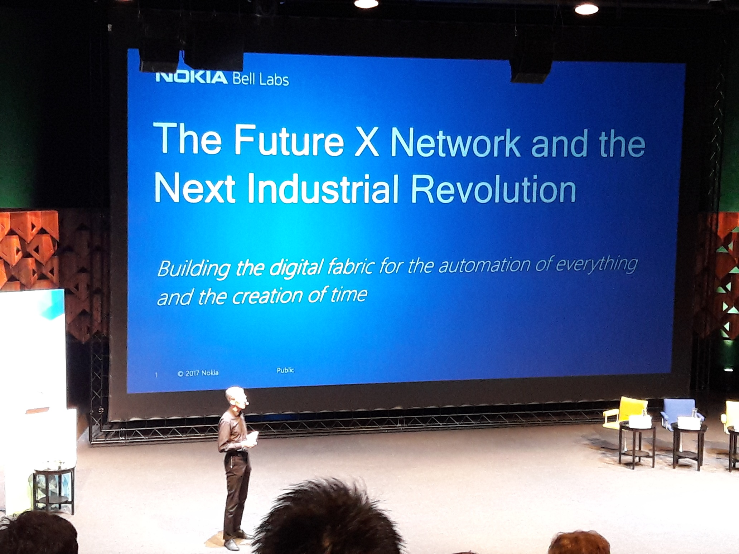

Slide 5

Ways to save/create time
Ways to save/create time
Change Time: Use differences in gravity and velocity
Change Lifetime: Discover “Fountain of Youth” or bioengineered equivalent
Change Usage of Time by Reducing Distance!

Slide 6
The Revolution
Tech. Revolution | Enabling Technology | Connectivity
Financial (1600 − 1740) | Stocks & Bonds | Banking & Stock Market Infrastructure
1st Industrial (1780 − 1840) | Steam Engine & Iron Production | Rail and Shipping Networks
2nd Industrial (1880 − 1920) | Steel & Chemicals | Extended Transportation Networks Electricity & Telecom Networks
Scientific-Technical (1940 − 1970) | Analog & Digital Signal processing | Digital Communications Networks
Information (1985 − 2015) | The Web, Cloud computing & Mobile devices | Internet & Broadband Access
Automation of Everything (2015 − ) | Digital interfaces & Data analysis | Future X Network: Create Time!

Slide 7






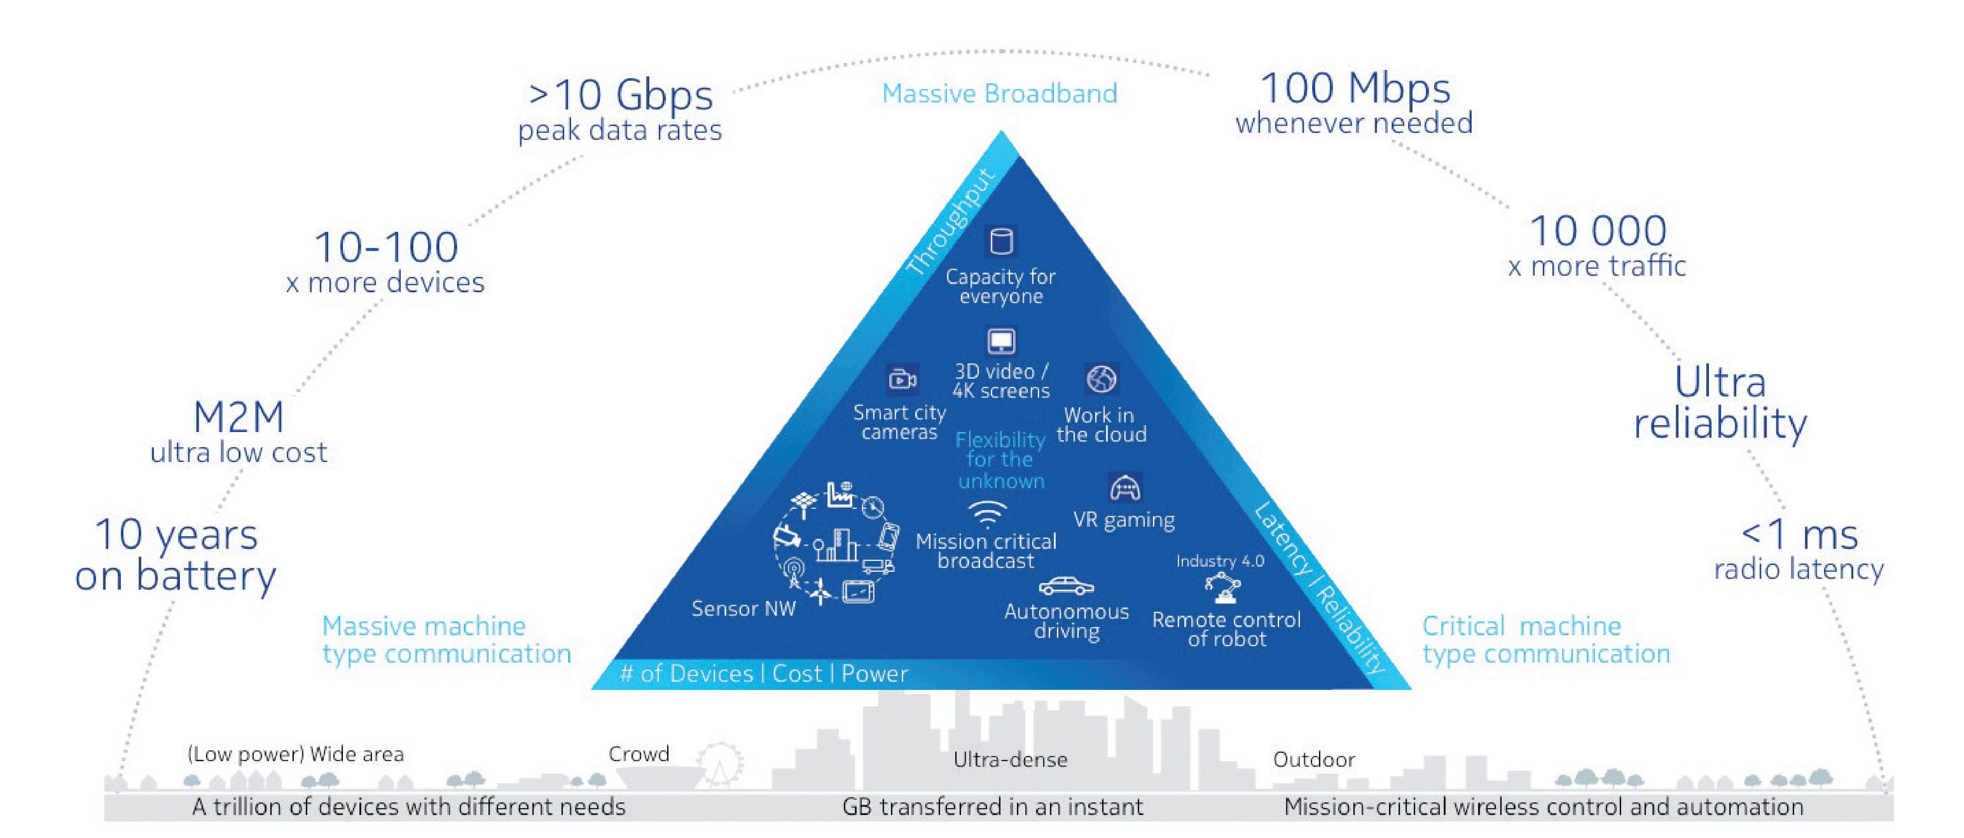

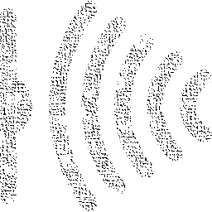

No communication limits…
What does 5G bring to us?
Sensing (Rx)
Actuation (Tx)
Massive Broadband
Real-time Interaction
Critical Low Latency
“Tele” Presence
Massive IoT
Information
Example:
mmWave and THz
Micro/Nano sensors

Slide 8








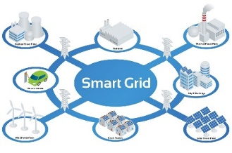







Challenge: How does 5G affect our lives from its starting date?
5G is NOT about more
speed or lower latency
All aspects of our lives affected
Can not just turn off our phones and get disconnected!
Department of Electrical Engineering - Sharif University of Technology

Slide 9

Networks of 5G and Beyond
Cognitive radios
Self-organizing networks
Flexibility
Machine Learning
RRH + BBU
SDN
Alive
NFV
Big data
Robustness
Self-Adaptation
Massive IoT
RF/Antennas/Fiber: Sensing and Actuation Fog/Cloud Processing: Brain-power Communication pathways
(CT + IT + Control)
….

Slide 10

Control blocks of industrial robot automation (Nokia)
Requirements:
Safety, Speed, Precision, Accuracy,
Reliability, Adaptability
Moore’s Law
AI Systems
Response Time
Anticipate/
Control
Act at a
distance
Digital Models
of the Physical World
Telepresence
(VR, Haptics)
Device
Physics, Chemistry, Materials
Speed of Light
Sense
Actuate
System Engineering
& Physics
Network Needs:
Bandwidth
Latency
Scale
Security
Digital Nervous System
Hyper-automation

Slide 11






Platoon Collision Avoidance
Networked acceleration, steering and braking control
(inter-vehicular sensing and actuator control)
Latency of 1 ms vs 100 ms @ 100 kmph provides additional safety margin of ~½ car length

Slide 12
The Intelligent Network
Digital Value
Platforms
7
ANP, CSP, ICP, Vertical apps
External data sources
Augmented
Cognition Systems
6
Analytics
Machine
learning
Open APIs
Programmable
Network OS
Dynamic
customer
services
Management &
Orchestration
Dynamic
network optimization
Multi-operator
federation
5
SDN
NFV
4
Universal
Adaptive Core
Common data layer
Access agnostic
converged core
modular, decomposed
network functions
Short
waves
& wires
self-optimized
coverage
& capacity
3
Smart Network Fabric
Long
fibers
Humans
& Machines
Massive
Scale Access
Converged
Edge Cloud
Access
Remote
1
2
Software defined, end-end

Slide 13
Opportunities
Important to Note:
1.TX/RX blocks are key innovative HW Communication parts to be designed and built.
2. The SW blocks are not IT software that are implemented by SW Engineers.
3. The SW is TELCO SW handled by Telecom Engineers who also know software tools.
Such Engineers are the key people we need in the country for coming years!
HW
SW
SW
SW
SW
SW
SW
HW + SW
TX/
Actuating
SW
SW
SW
SW
SW
RX/ Sensing
RX/ Sensing
SW
SW
HW
SW
SW
HW + SW
RX/ Sensing
SW
SW
SW
SW
SW
SW
SW
SW
HW
Generic HW
TX/
Actuating
HW + SW
TX/
Actuating
SW
Department of Electrical Engineering - Sharif University of Technology
Notes:
Here change the text “Vendor” to “HW + SW”. I changed the first one, pls change the other two.
Also, change the color of these boxes from Yellow to Red, Light and Dark Blue.
Then when they are divided into two parts HW and SW, keep the same 3 colors for the 3 boxes.
When the new SW and Sensing and Actuating boxes appear, move the Generic HW box to the middle in the lower row, remove the 12 SW boxes that exsitsed before and just show the new SW and Sensing + Actualting boxes distributed around the slide on over the generic HW box.

Slide 14
So what are the KEY areas in years to come?
A “generic” processing hardware can be used to implement a large set of functionalities (virtual machines)
A better understanding of SW and Operating Systems is needed:
  Software Defined Networking (SDN)
  Network Function Virtualization (NFV)
But: New hardware in sensing and actuation is the key:
  Electronics and Electromagnetics will be the key
  mmWave, Massive MIMO,…
More intelligence in the network: Learning – Big Data Analytics – Artificial Intelligence (AI)
Interactions between Cloud Computing and Storage
Control and Feedback: Always a key element in Life and now in everyday Networks!

Slide 15
Few Coming Years:
One of most exciting and challenging eras for Communication Industry
with close Interaction with SW, Control, AI, …
Welcome aboard such excitement!!

